Slide 1
Network Layer

Slide 2
Responsibilities:
Switching
Logical Addressing
Routing
Congestion Control

Slide 3
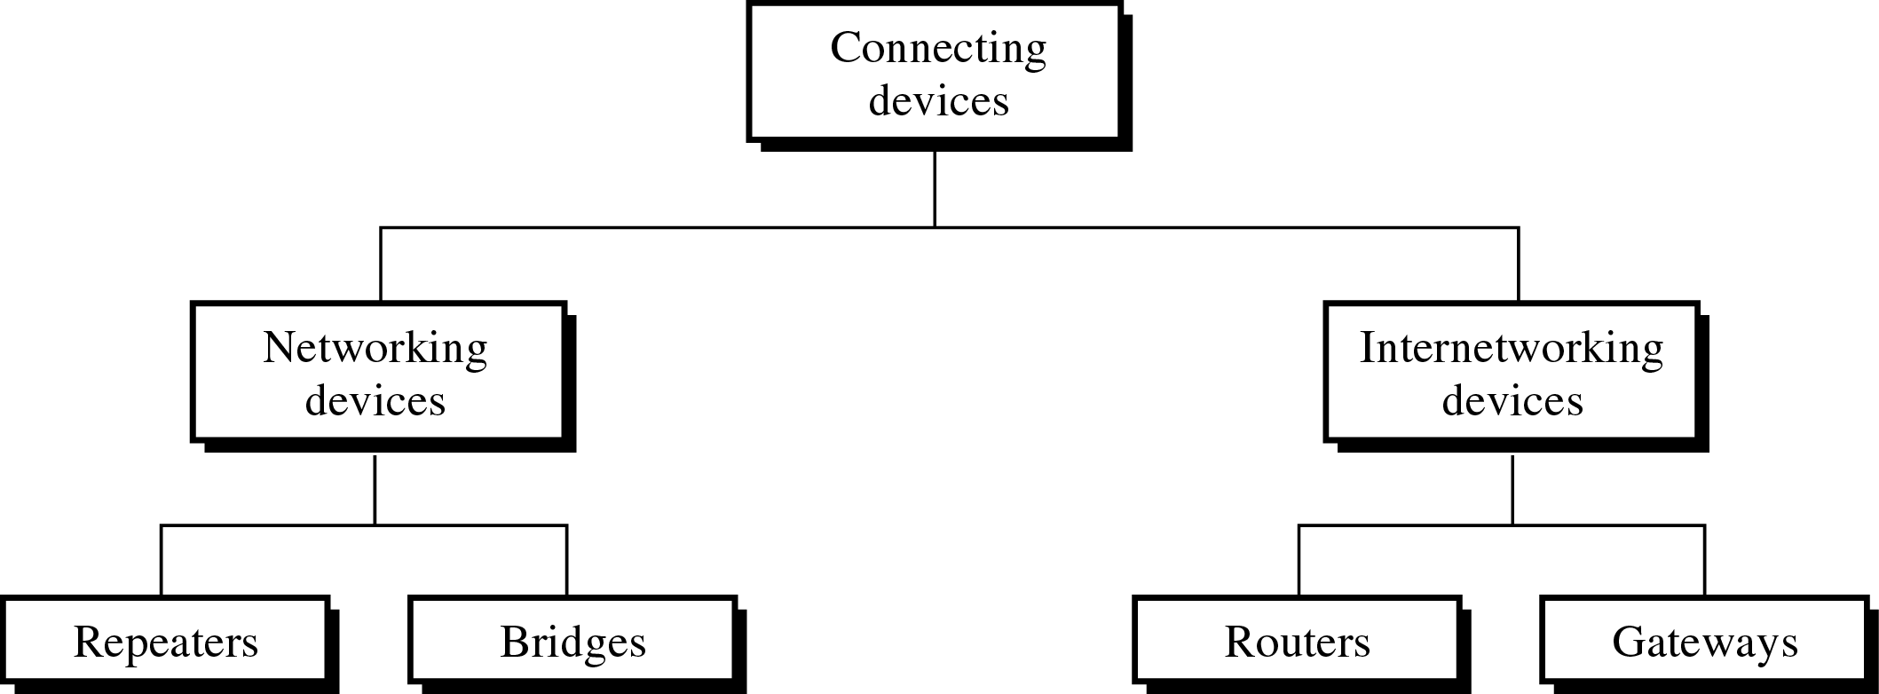
Connecting Devices

Slide 4
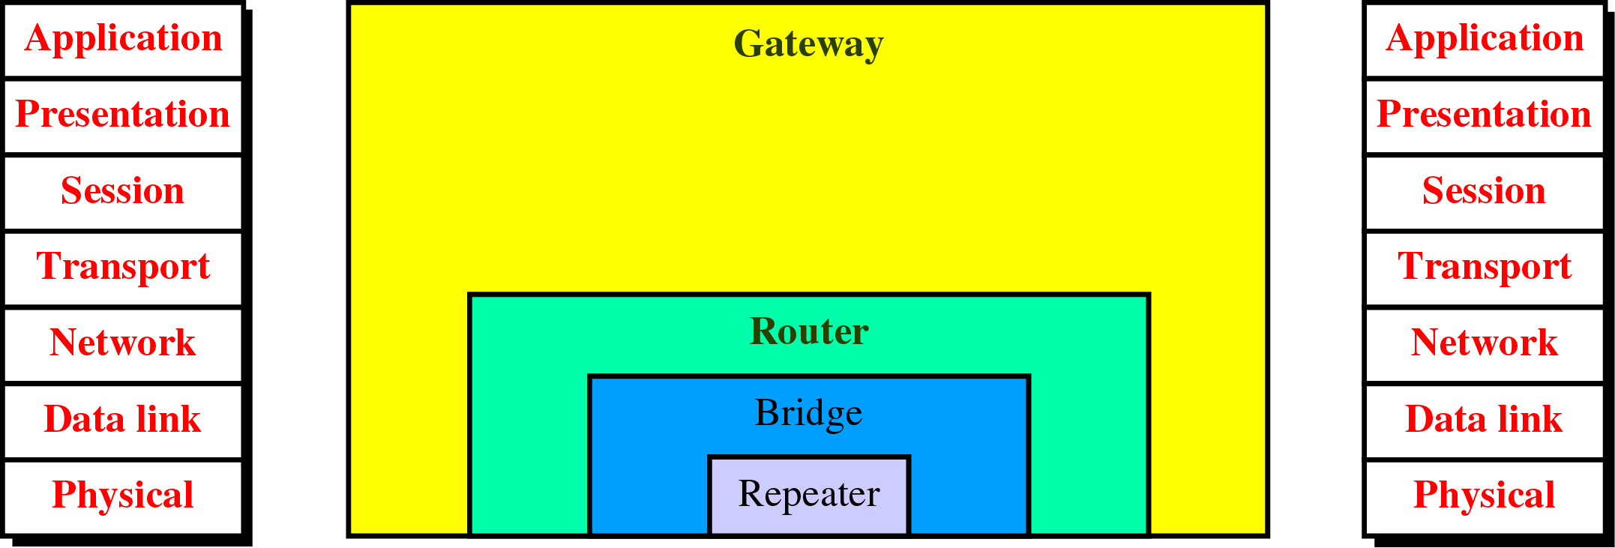
Connecting Devices and the OSI Model

Slide 5
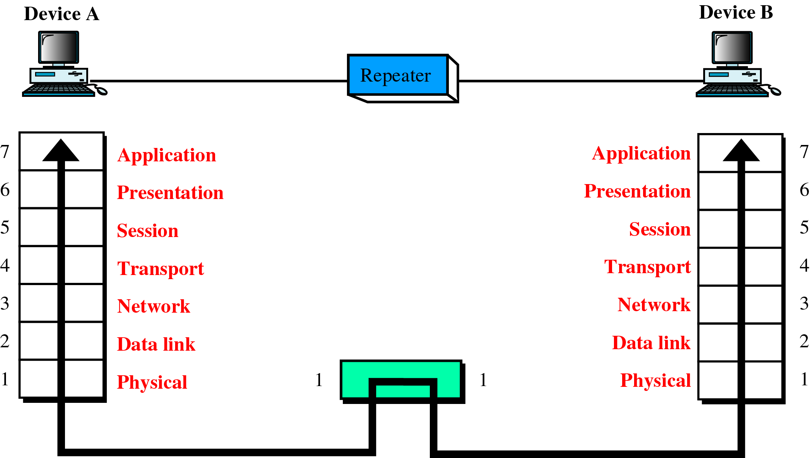
A Repeater in the OSI Model

Slide 6
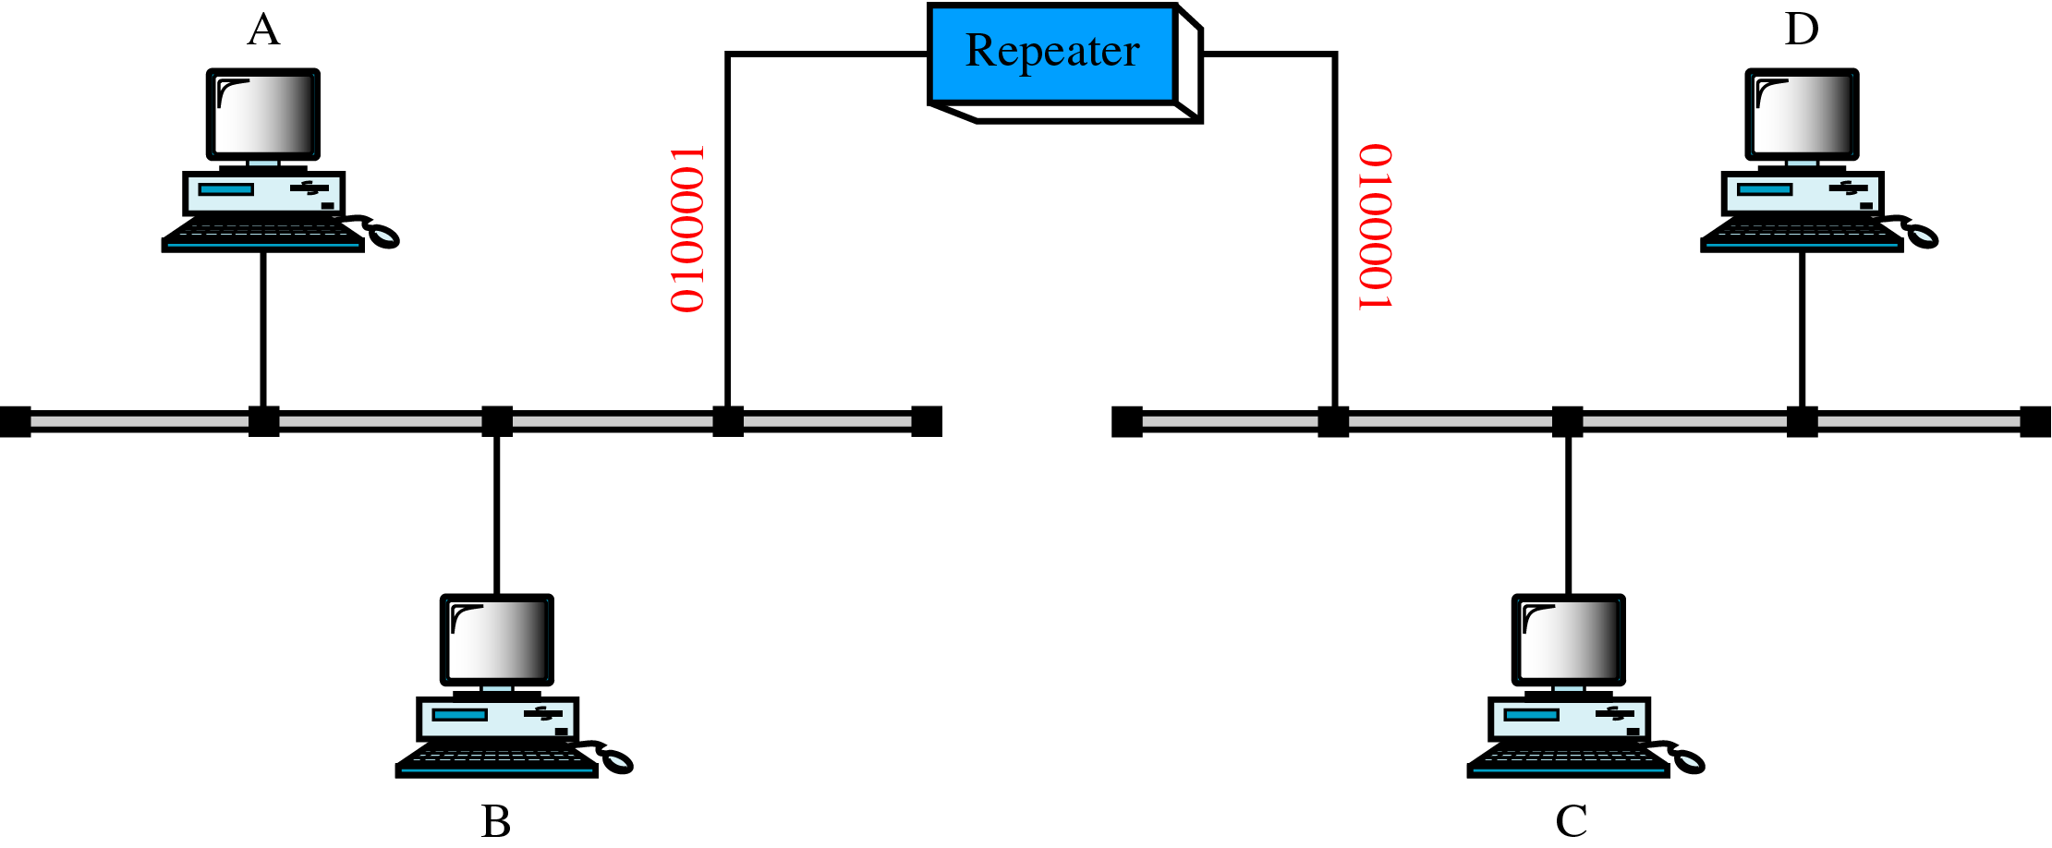
A Repeater

Slide 7
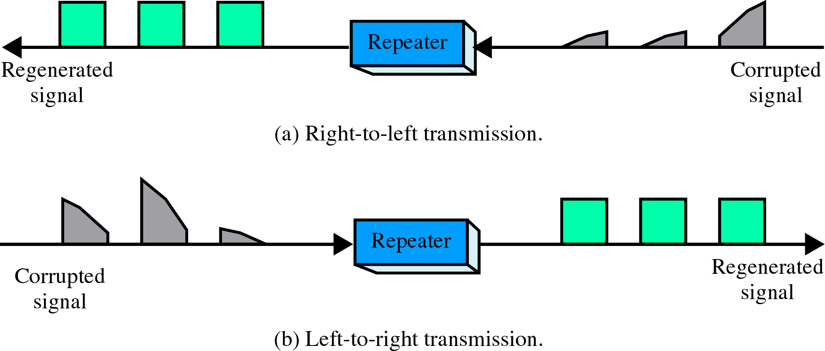
Function of a Repeater

Slide 8
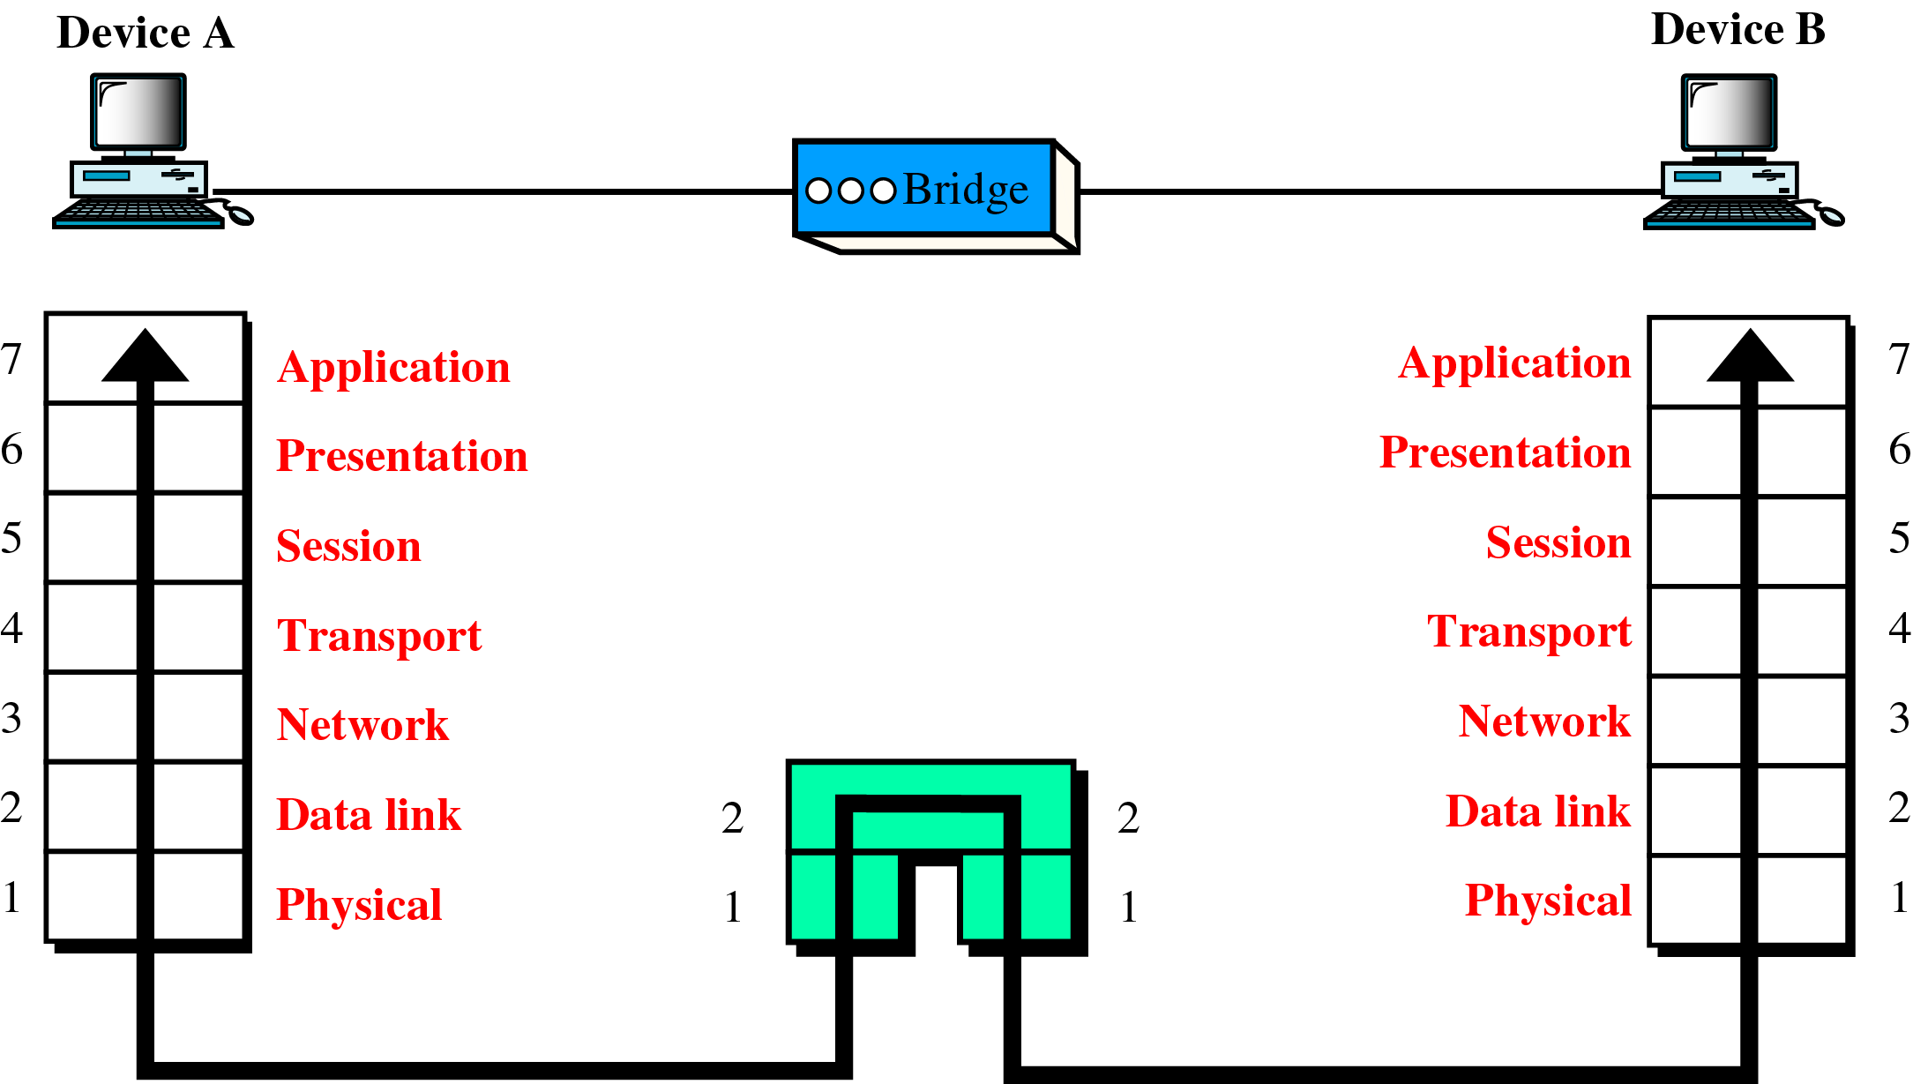
A Bridge in the OSI Model

Slide 9
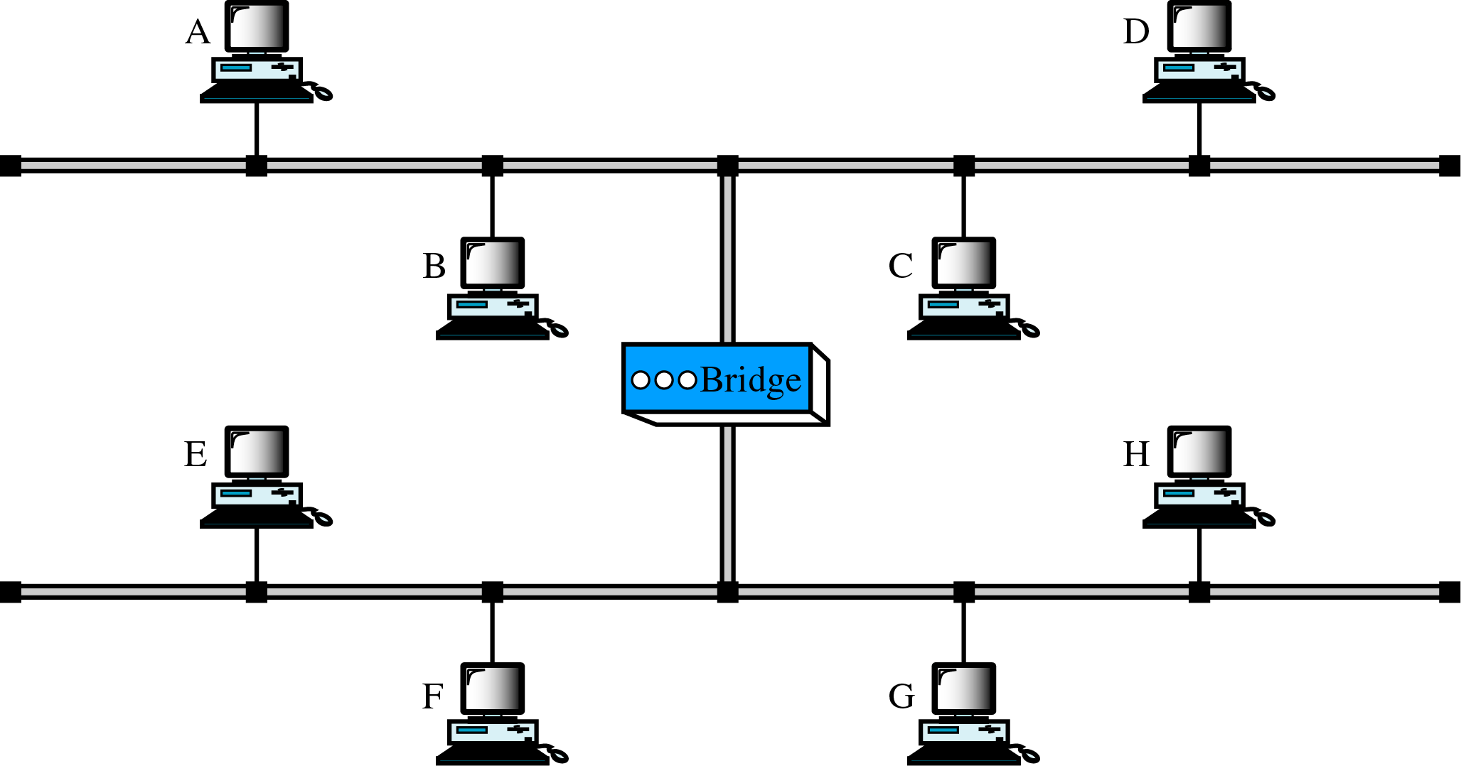
A Bridge

Slide 10
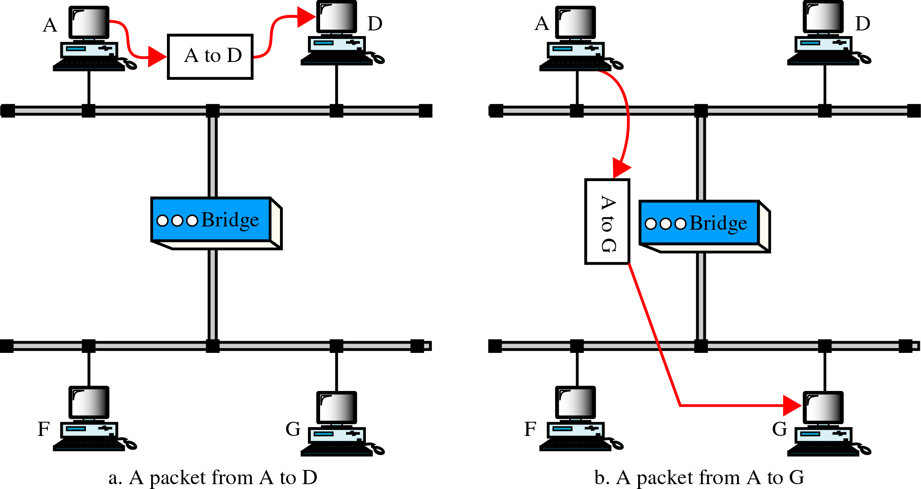
Function of a Bridge

Slide 11
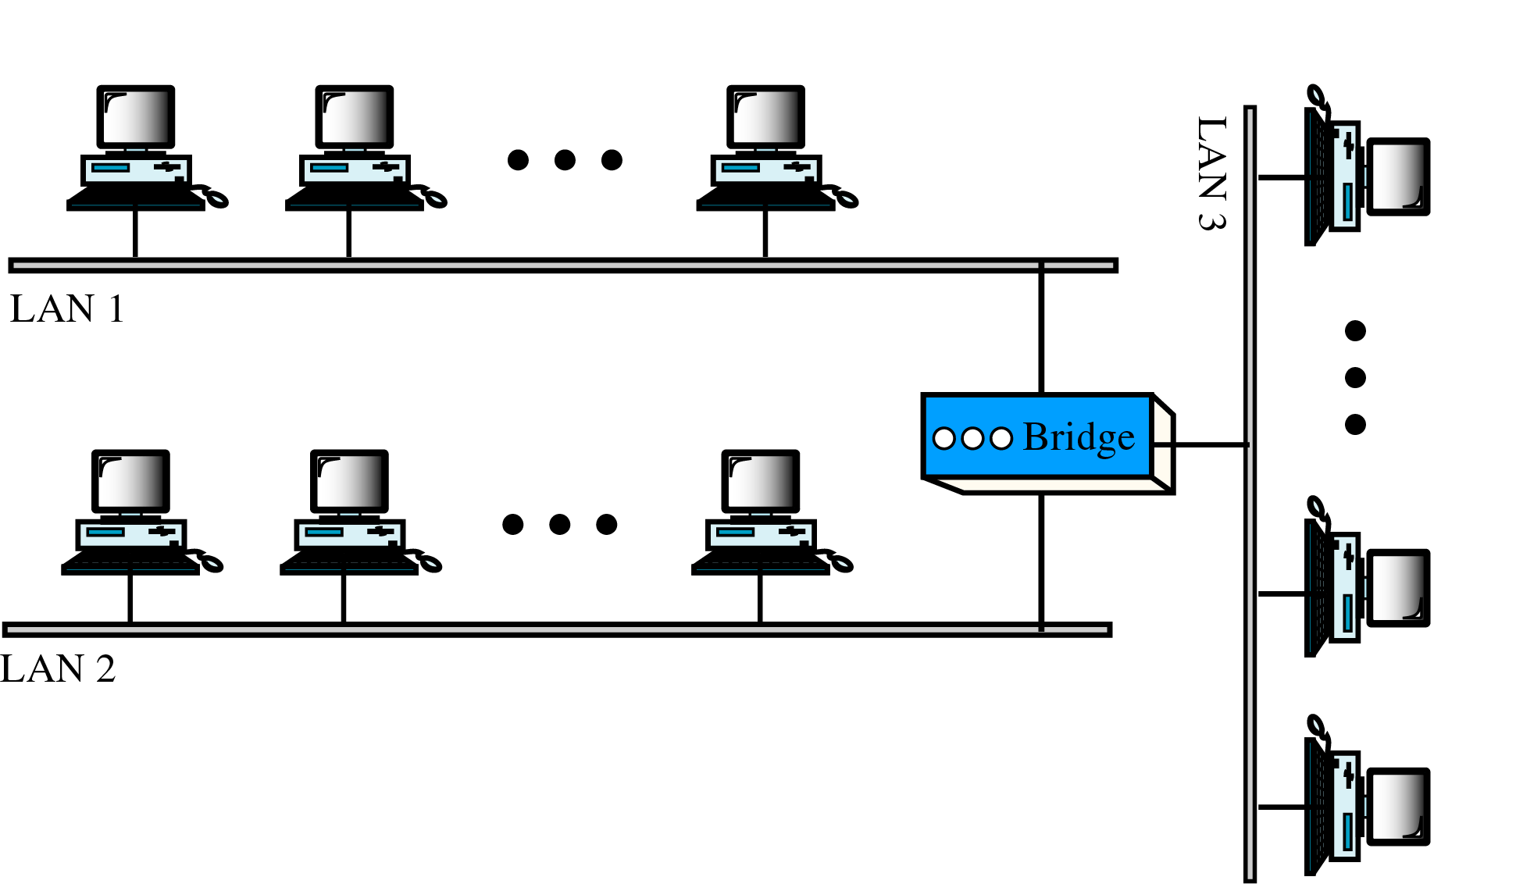
Multiport Bridge

Slide 12
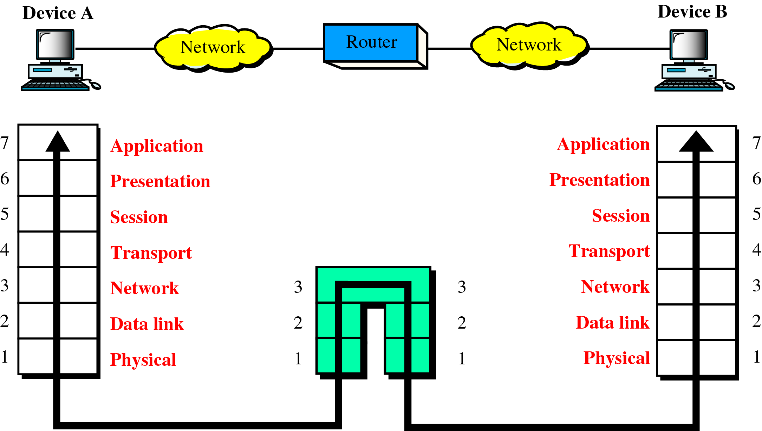
A Router in the OSI Model

Slide 13
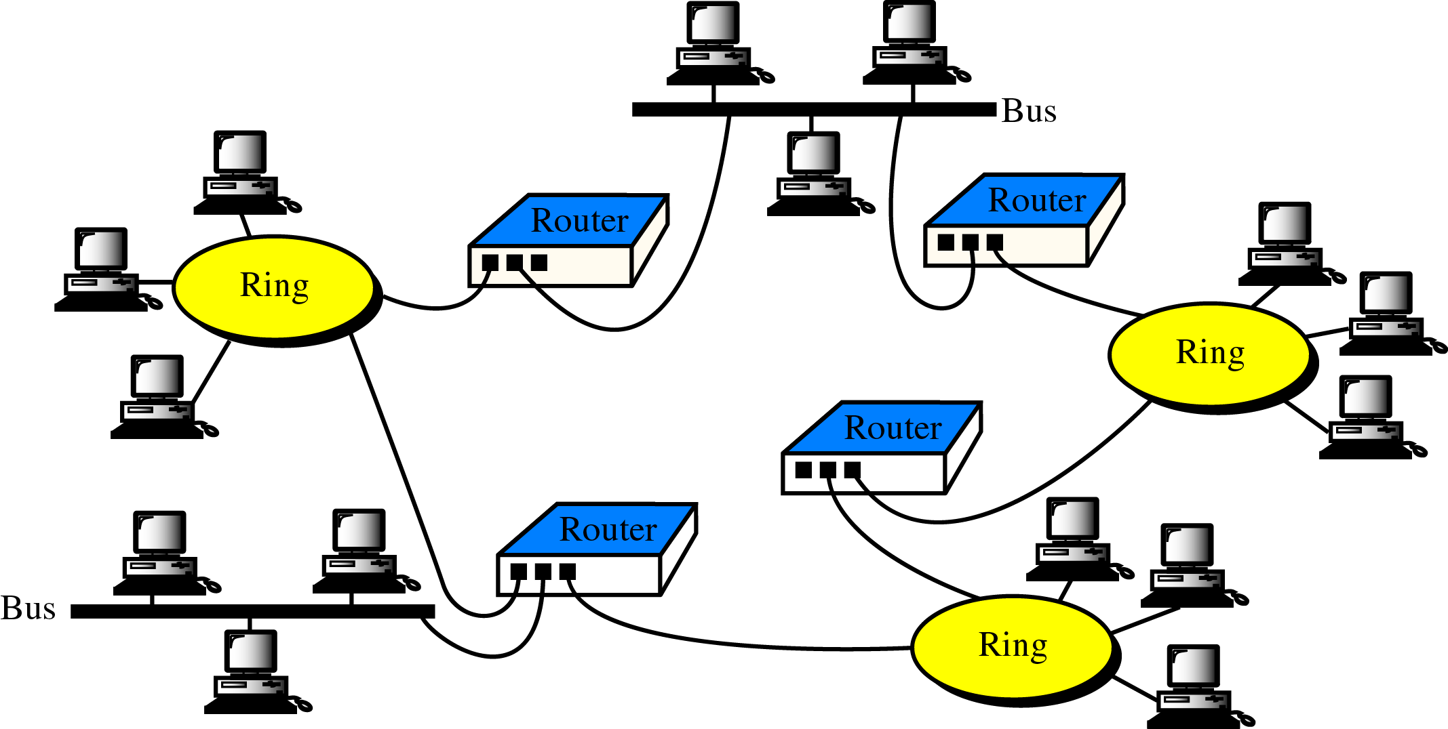
Routers in an Internet

Slide 14
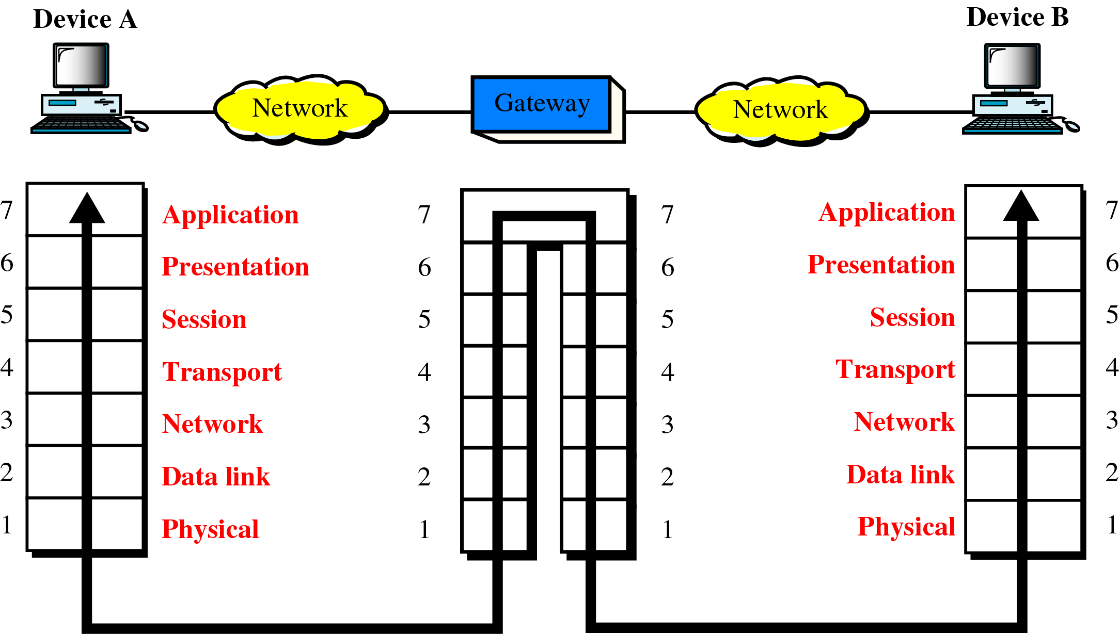
A Gateway in the OSI Model

Slide 15
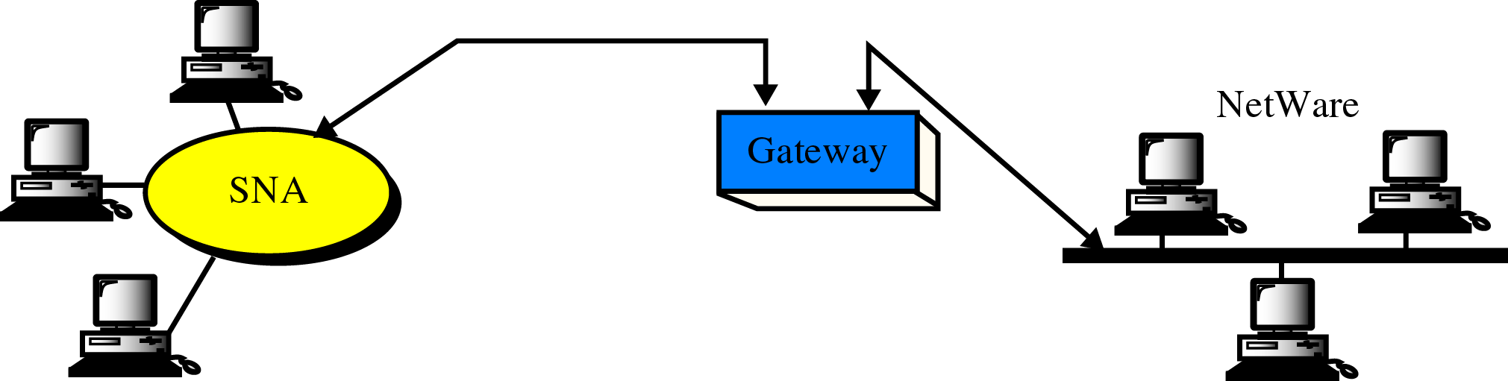
A Gateway

Slide 16
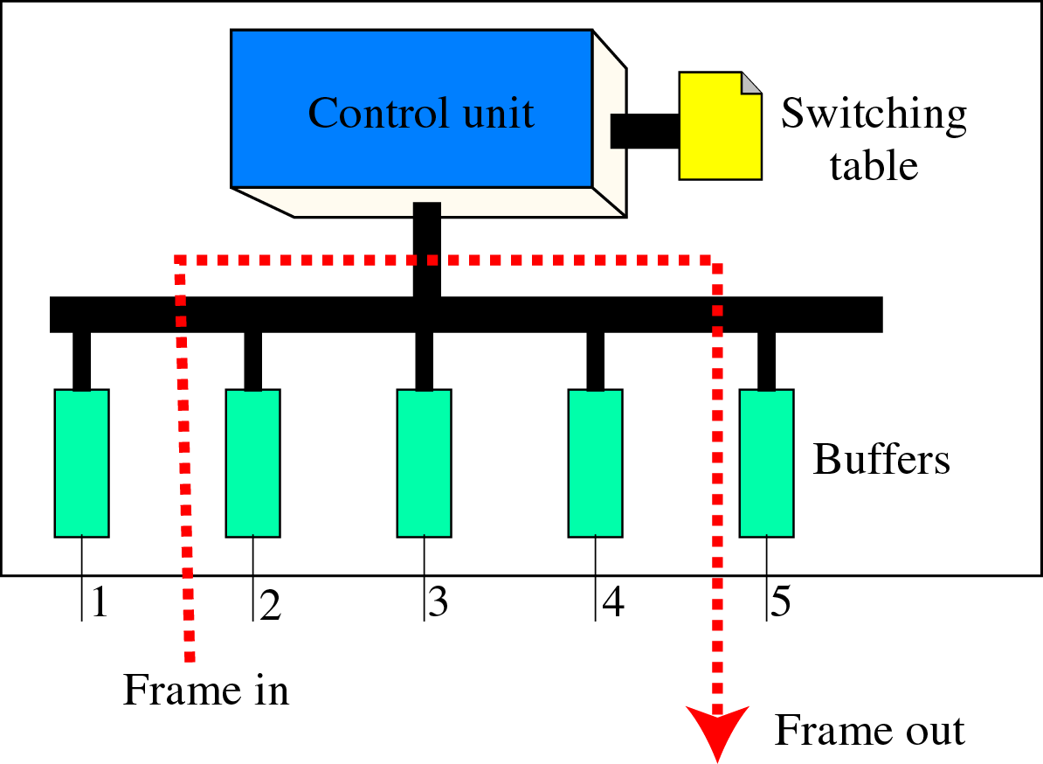
Switch

Slide 17
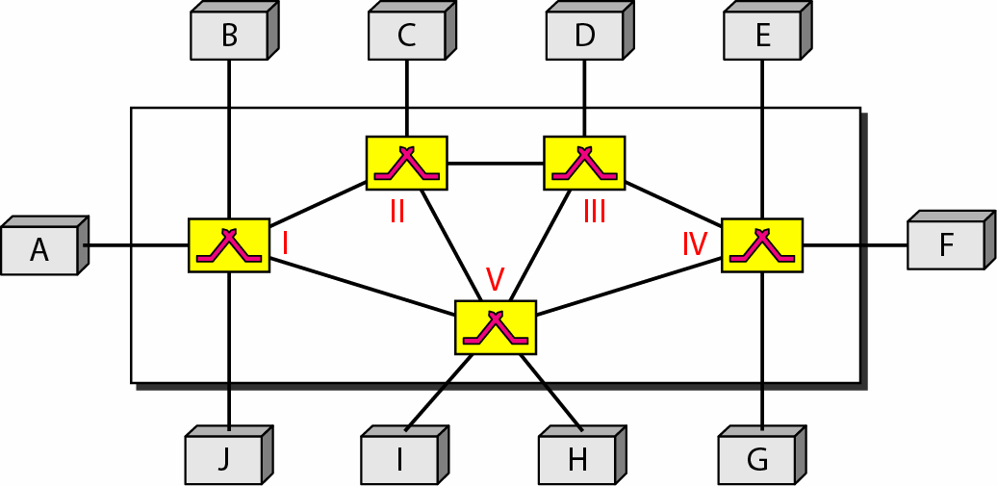
Switched Network
Consists of a series of interlinked nodes called switched.
Switches are capable to create temporary connections between two or more devices

Slide 19
Circuit-Switched Network

Slide 20
Transmission phases
Setup phase
A dedicated circuit needs to be established
So create dedicated channel by sending a request

Slide 21
Transmission phases
Data transfer phase
Teardown phase
Signal is sent to each switch to release resources

Slide 22
Delay

Slide 23
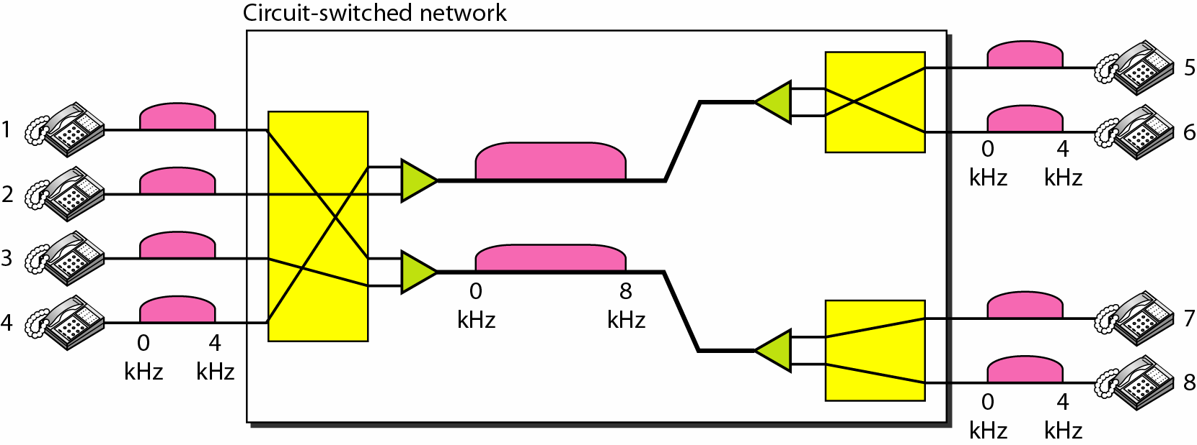
Example

Slide 24
Datagram Switching (Packet switching)

Slide 25
Routing table & Destination Add.
A switch in a datagram network uses a routing table that is based on the destination address.
The destination address in the header of a packet in a datagram network remains the same during the entire journey of the packet.

Slide 26
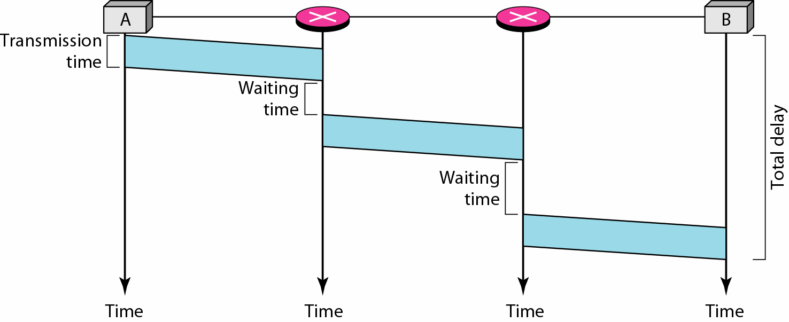
Delay
Total Delay = 3T + 3t+ w1+ w2

Slide 27
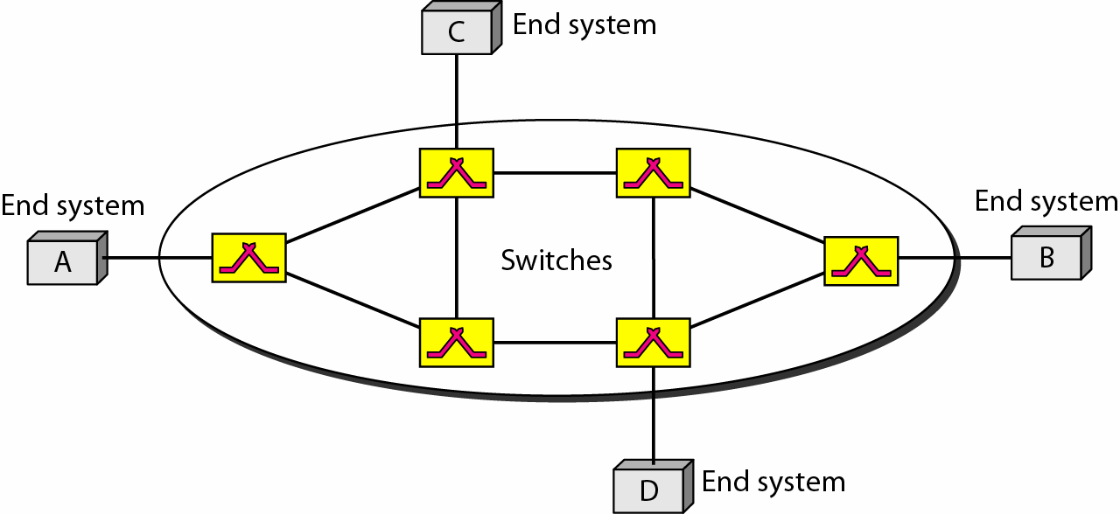
Virtual-Circuit Network

Slide 28
Addressing

Slide 29
Transmission phases
Setup phase
A switch creates an entry for a virtual circuit.
Request
acknowledgment

Slide 30
Setup

Slide 31
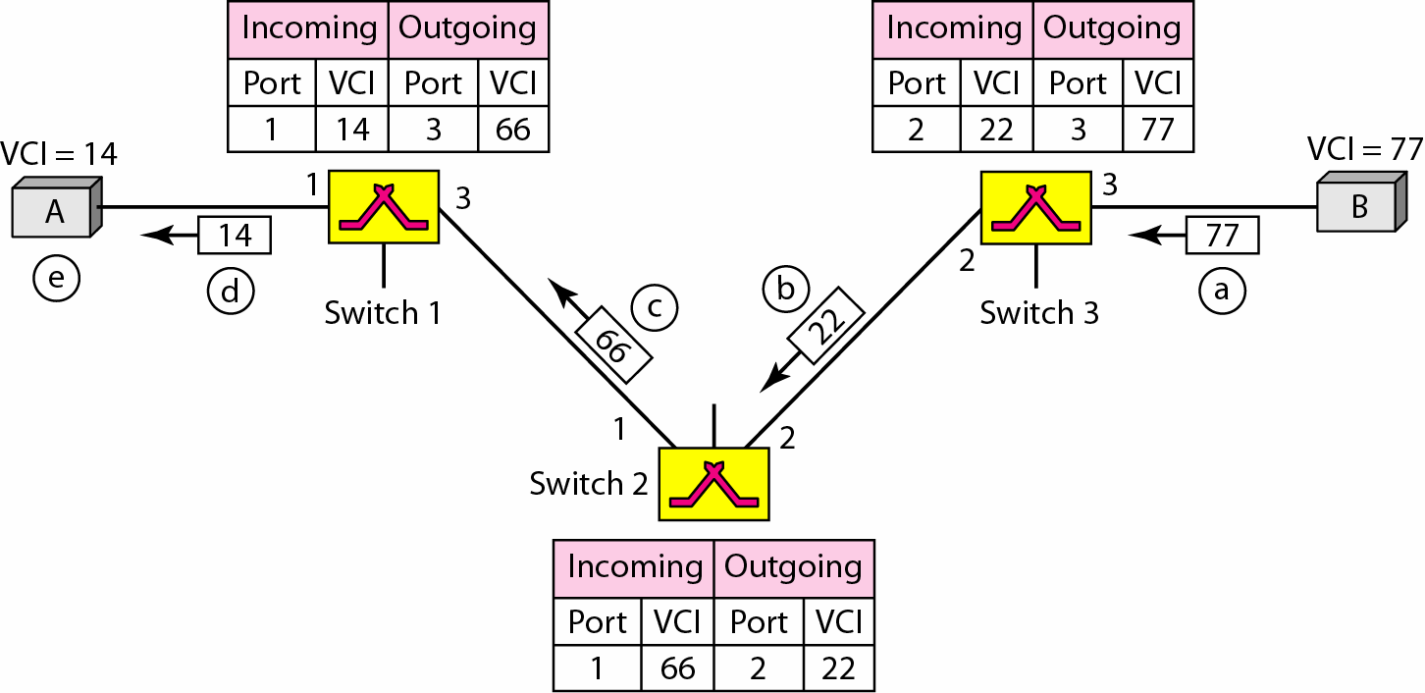
acknowledgment

Slide 32
Data transfer and teardown phases

Slide 33
Delay
Total delay = 3T + 3ζ+ setup delay + teardown delay

Slide 34
8-4 STRUCTURE OF A SWITCH
We use switches in circuit-switched and packet-switched networks. In this section, we discuss the structures of the switches used in each type of network.
Topics discussed in this section:
Structure of Circuit Switches Structure of Packet Switches

Slide 35
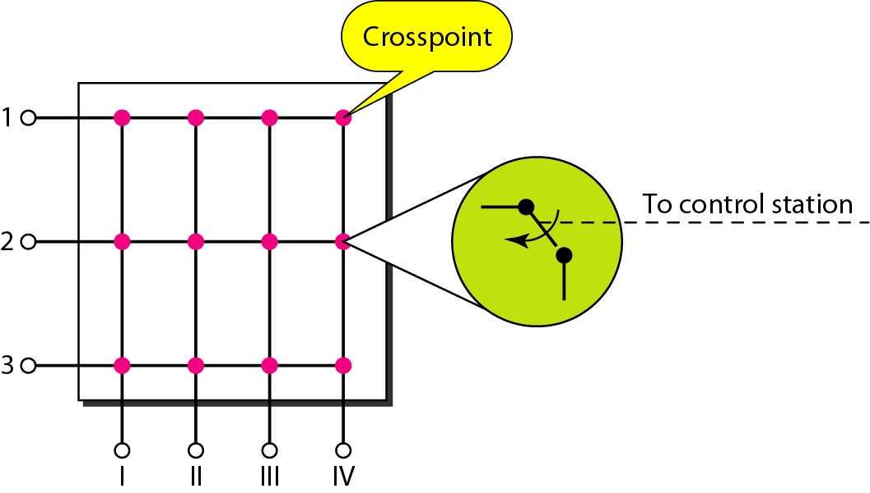
Figure 8.17 Crossbar switch with three inputs and four outputs

Slide 36
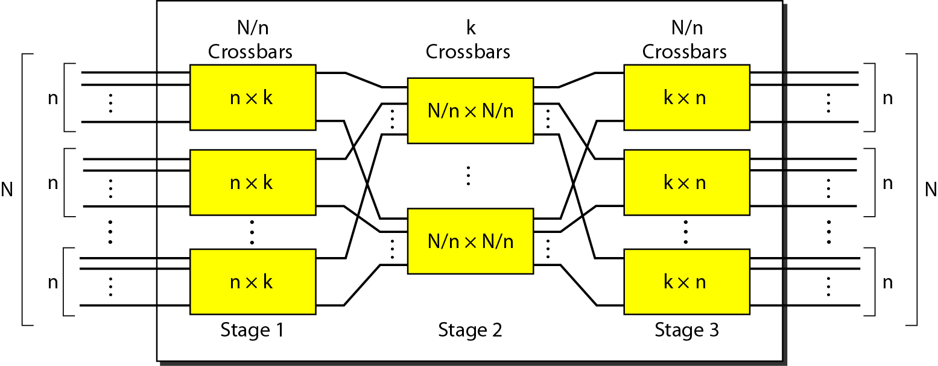
Figure 8.18 Multistage switch

Slide 37
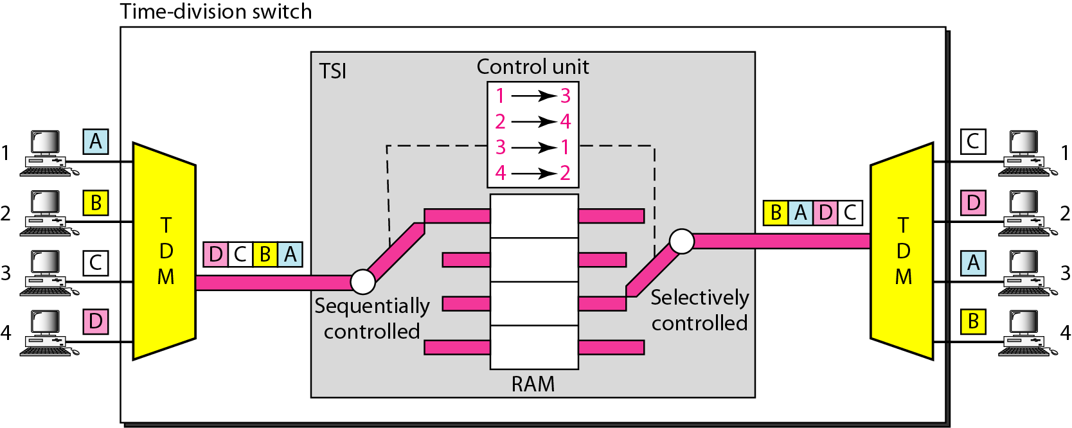
Time-slot interchange

Slide 38
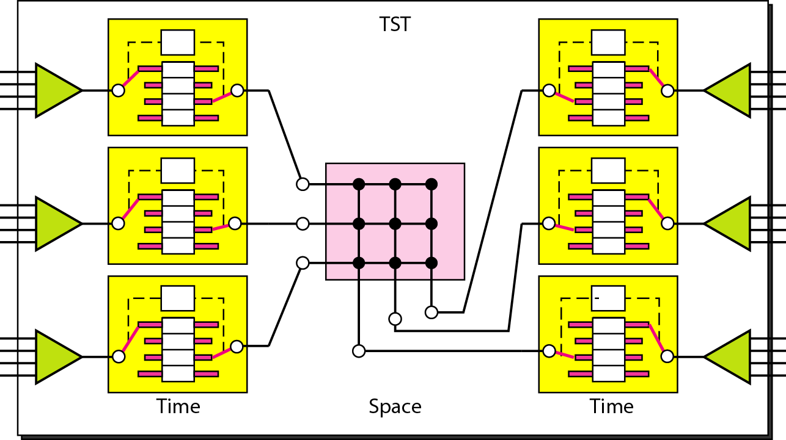
Figure 8.20 Time-space-time switch

Slide 39
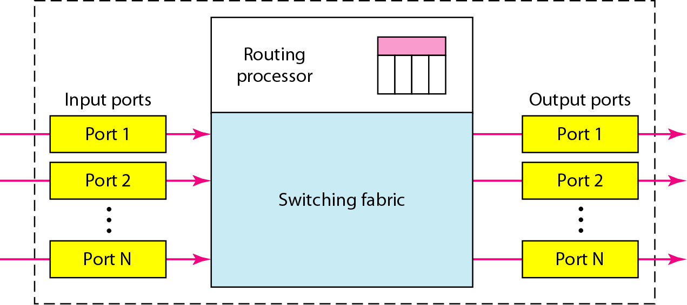
Figure 8.21 Packet switch components

Slide 40
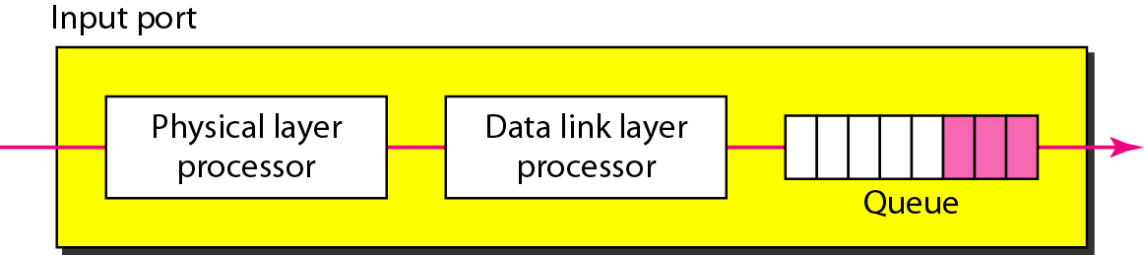
Figure 8.22 Input port

Slide 41
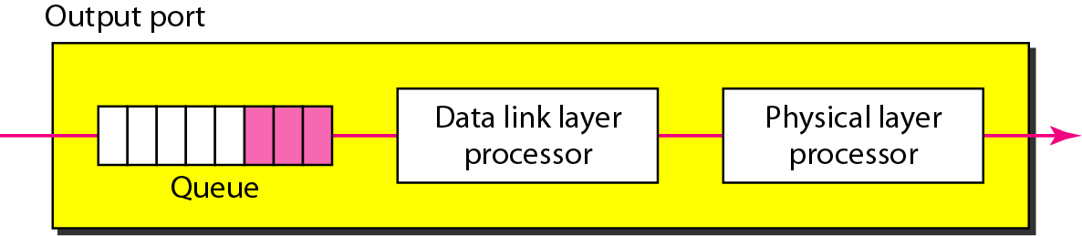
Figure 8.23 Output port

Slide 42
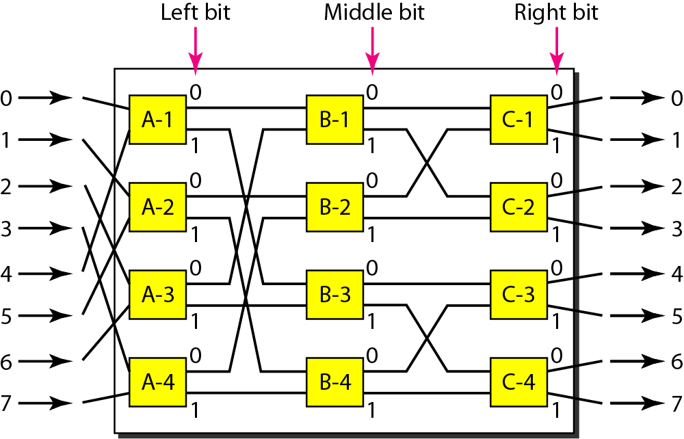
A banyan switch

